Slide 1

ADVENTURE WORKS (POWER BI)
Jayanthy Prahashit
Jahnavi Adapa
Rohit Rajesh Chavan
Alsha Kumari
Prerana Shubham Alande
Somya Ranjan Behera
Sumit Kumar Nayak

Slide 2
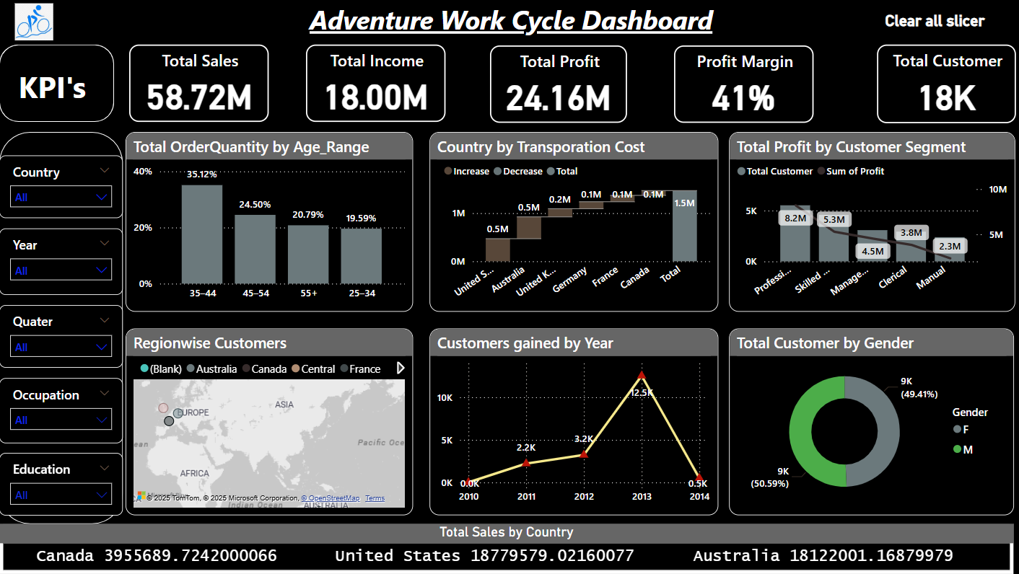
DASHBOARD 1

Slide 3
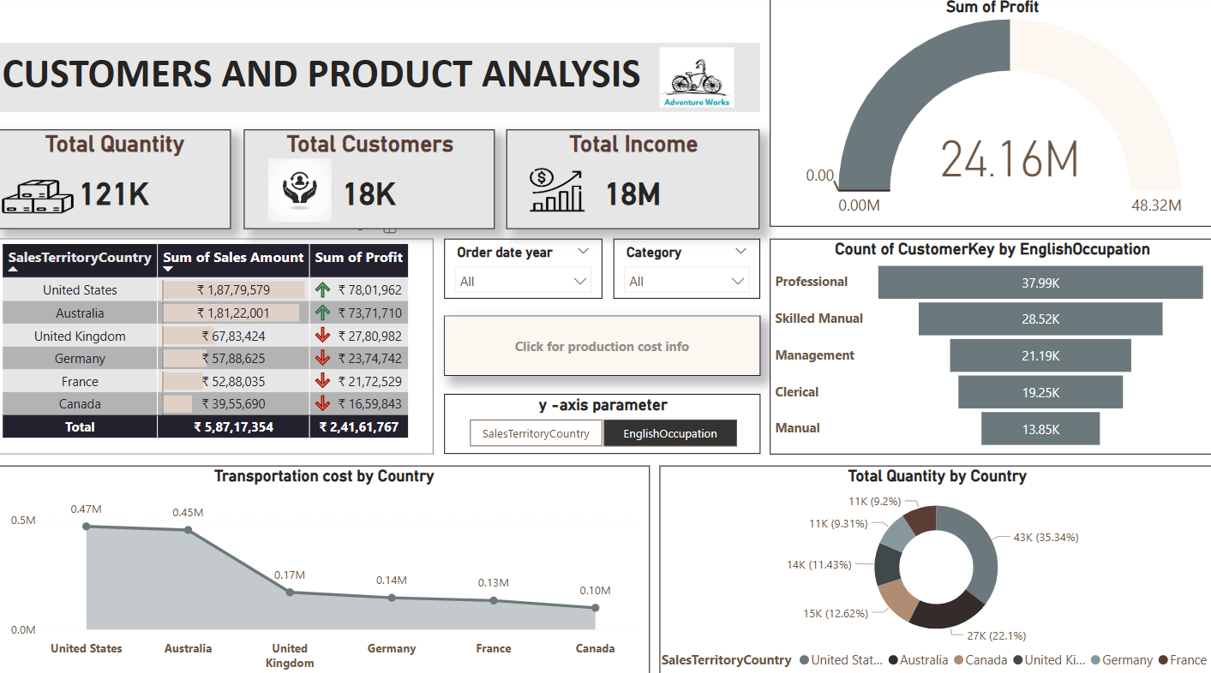
DASHBOARD 2

Slide 4
THANK YOU

